Slide 1
PROPOSED STUDENT HUB FACULTY OF MEDICINE UNIVERSITY OF PERADENIYA

Slide 2
Proposed Student Hub

Slide 3
Why We Need a Student Hub???
With the intensity of the medical curriculum and the high demand, work at times could be overbearing for both students and staff alike
Therefore, having an area dedicated for recreational activities could promote workspace wellbeing and harmony
The present student canteen is highly inadequate, substandard and in a dilapidated condition.

Slide 4
Potential Donors
University of Peradeniya
Faculty of Medicine – earned funds from foreign students
PeMSAA Sri Lanka
PeMSAA UK
PeMSAA Australasia
PeMSAA USA
Individual donations from well-wishers
Various fund raising campaigns
Student fund raising campaigns

Slide 5
Infrastructure
A canteen
Recreational area including a mini gymnasium
Wash rooms
A book shop
An e-counter
Teller machines
Photocopying and type setting facilities
A gift shop
Laundry facilities
Wi-Fi zone
A lounging area
Saloon
Student union office
The PeMSAA office
A mini open-air theatre like "Wala" by the side of the student hub
A day care center

Slide 11
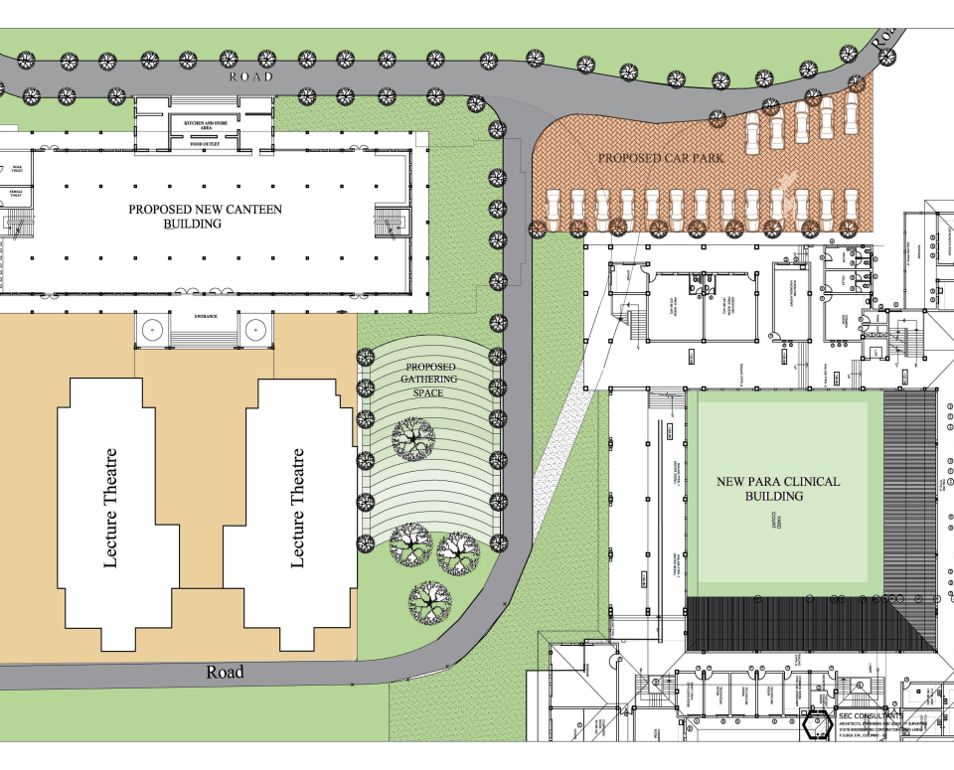

Slide 13
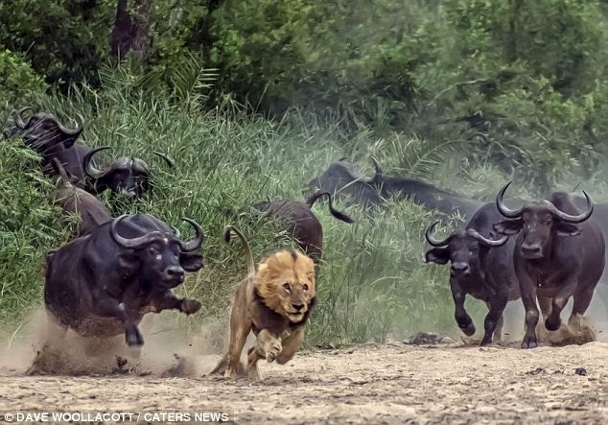
If we are united , nothing will be impossible

